Slide 1
EDU-PRO -CAFFEINATED CODERZ
Here’s to a new way for Smart Education

Slide 2
TEAM AND PROBLEM STATEMENT DETAILS
Ministry/Organization Name | National Digital Education Architecture (NDEAR), Department of School Education & Literacy (DoSEL)
PS Code | AK1090
Problem Statement Title | Multi User rapid dipstick phydigital Assessment/Surveys in low device environment
Team Name | Caffeinated Coderz
Team Leader | Anuj Khanvilkar
Institute Code | C-34167
Institute Name | Ramrao Adik Institute of Technology
Theme Name | Smart Education

Slide 3
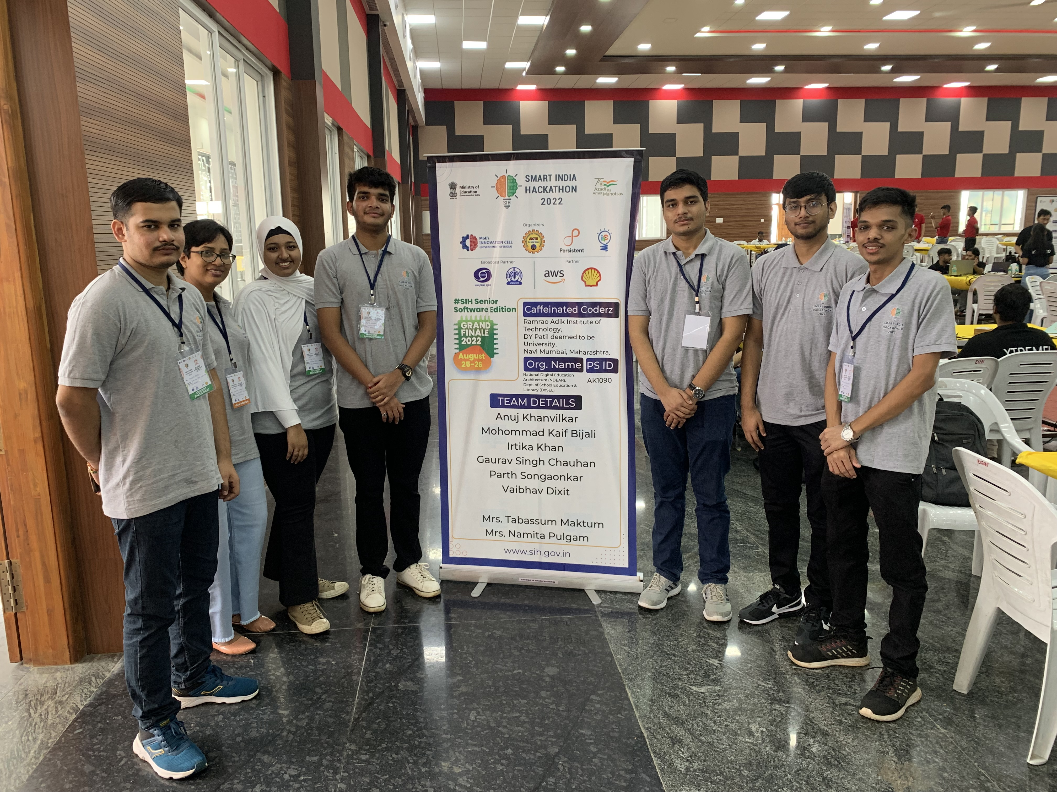
INTRODUCTION
Team Name: Caffeinated Coderz
Organization: Ramrao Adik Institute of Technology, D Y Patil University, Navi Mumbai, Maharashtra
Team Leader: Anuj Khanvilkar

Slide 4
PROBLEM STATEMENT
Develop a solution for early grades that leverages simple phone camera of smartphone to assess entire class’s understanding when students make choices using cardboards marked with choices, by leveraging image processing, OCR capabilities, machine learning among others. Team will build rapid assessment plugin to content editor to administer the quiz and feed the results automatically against every student profile. Teacher is able to see classroom performance instantly, will ensure rapid easy testing capability to teacher which will provide understanding of individual student learning progress, enabling her to ensure entire class is moving together in their learning journey and aggregate data is made available as data.

Slide 5
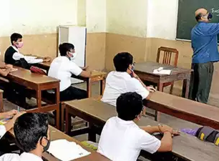
EXISTING SYSTEMS
Currently, we are using the traditional method for conducting examinations i.e pen and paper, with the help of OMR sheets.
This process is not centralized and creates a gap.
This involves manual correction of the exam/ quiz and result generation is time consuming.
Since this process is slow, it deteriorate the quality of work as well as the level of understanding.

Slide 6
PROPOSED SOLUTION

Slide 7
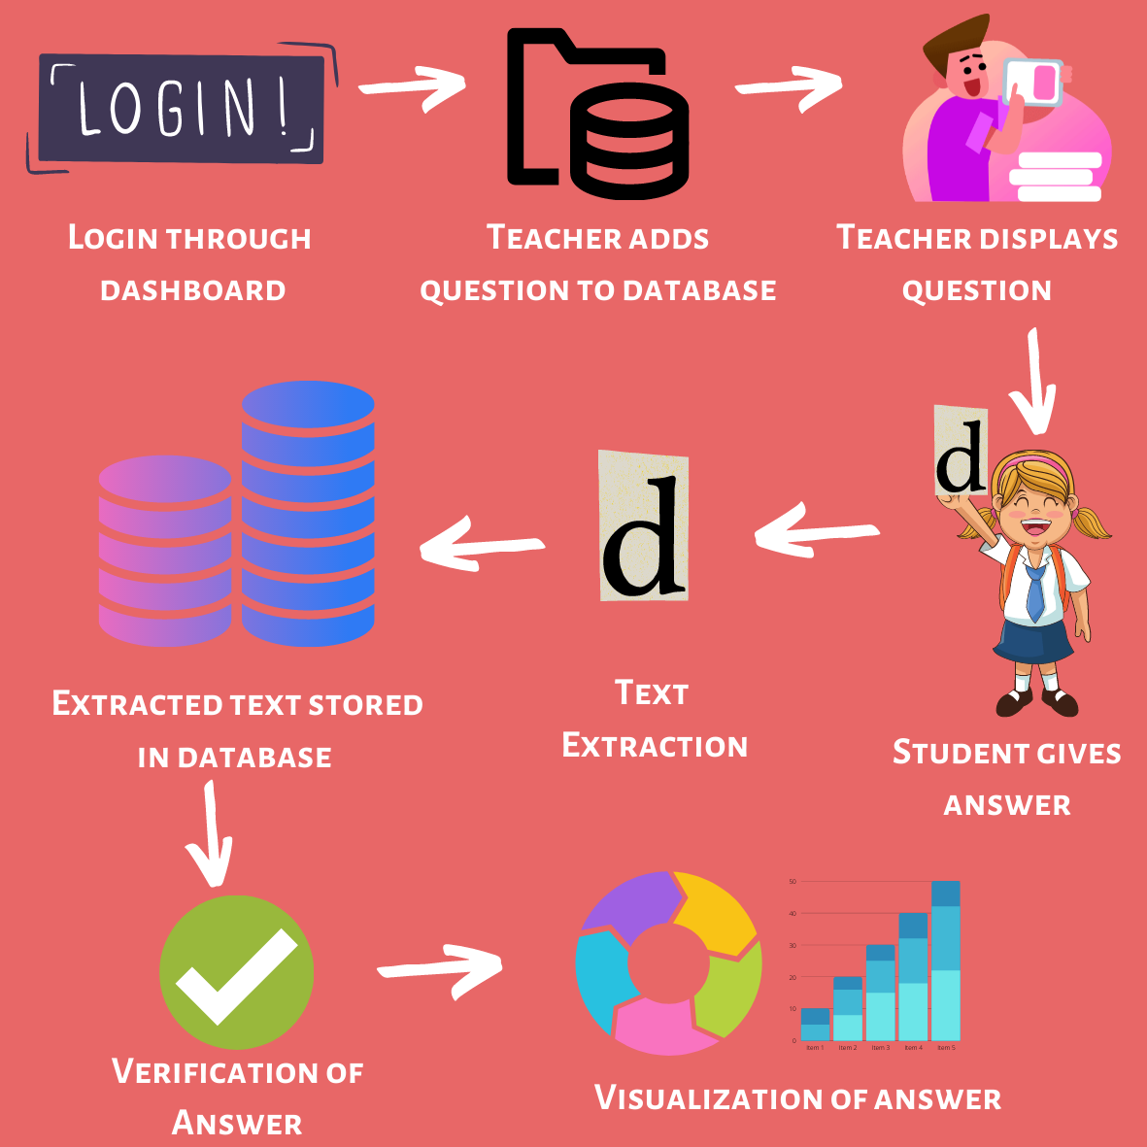
Developed a web based application for early grades with teacher login to access dashboard.
Teacher can access existing quizzes and also can create new quiz as per the requirement.
To answer the quiz, students would hold the placard in front of the camera and the answer will be saved in a database.
Teacher can check individual student performance immediately.
Also, students will be able to know their performance.

Slide 8
TECHNOLOGY STACK
01
02
03
PYTHON
OPENCV
EXCEL
Programming language used to develop the expression identification model.
Open-source library used to perform face detection.
The hosted database used to store the information.

Slide 9
TECHNOLOGY STACK
04
05
06
HTML, CSS
PYTESSERACT
JAVASCRIPT
Languages used to develop the Portal Dashboard and front-end.
Python, Scikit Learn.
Script used in backend of the Portal Dashboard.

Slide 10
IMPLEMENTATION
TEXT EXTRACTION
Step 1: Recognition of Region of Interest and ignoring the noises
Step 2: Recognizing the text in the Region of Interest
Step3: Extraction of text from the Region of Interest and store in the backend.
DATA VISUALISATION
Step 1: Retrieving the data from the backend
Step 2: Identify the data of interest.
Step 3: Visualize the data using various pie charts and bar graph.
ATTENDANCE RECORDING
Step 1: Student’s pictures are stored in the database.
Step 2:Face recognition model is trained for the job
The data is stored in the form of .csv file

Slide 11
RESULTS

Slide 12
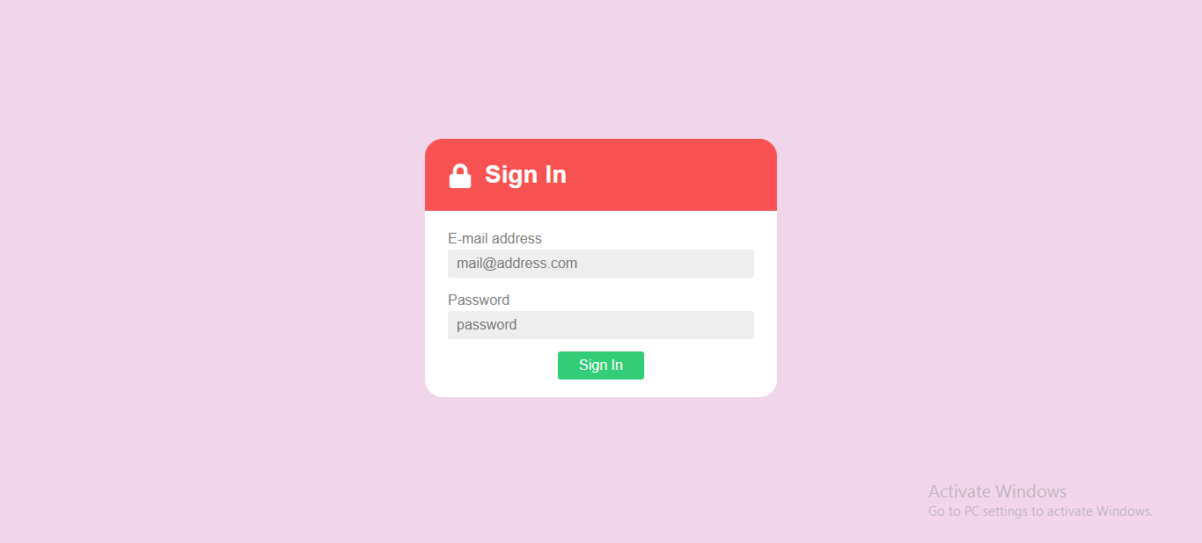
LOGIN

Slide 13
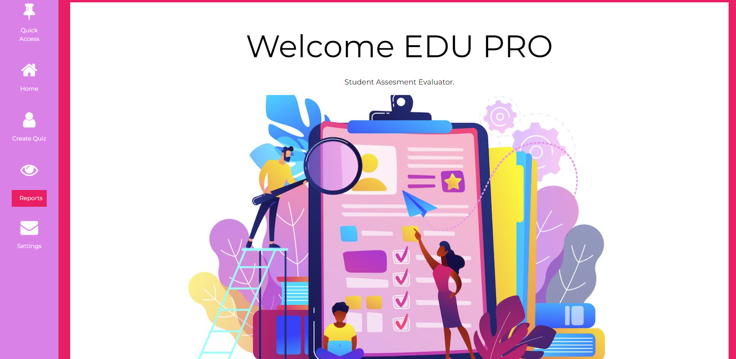
DASHBOARD

Slide 14
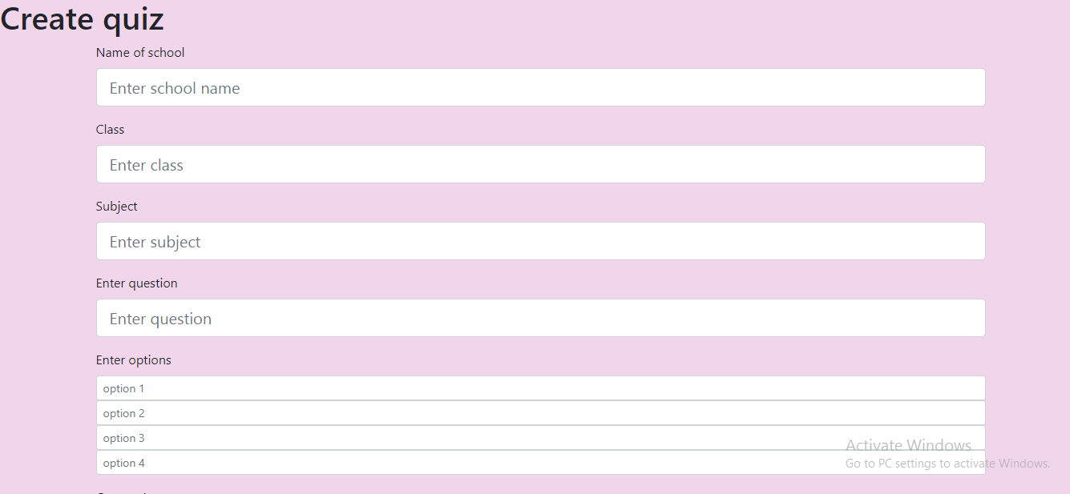
CREATE QUIZ

Slide 15
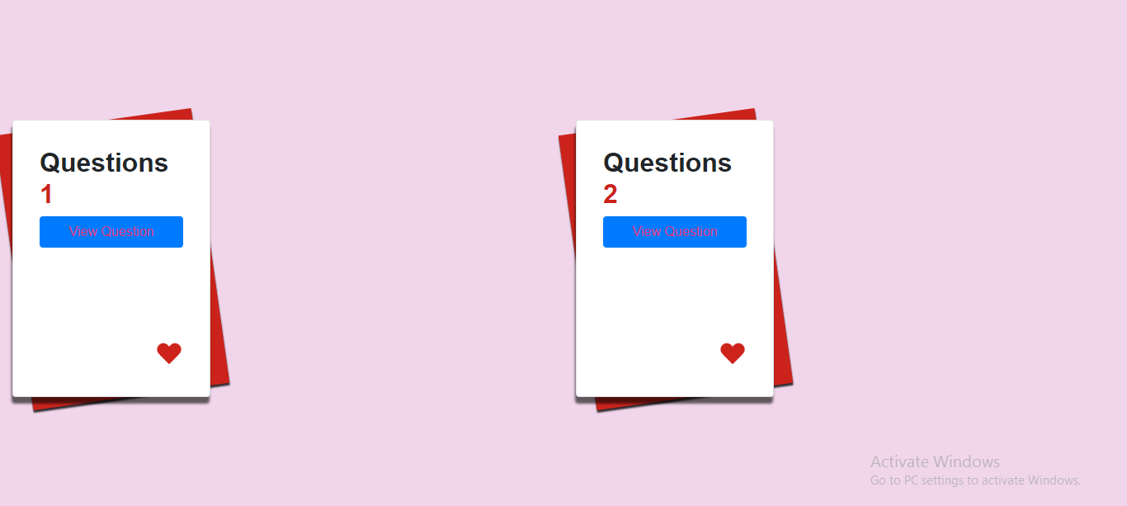
QUESTION DISPLAY

Slide 16
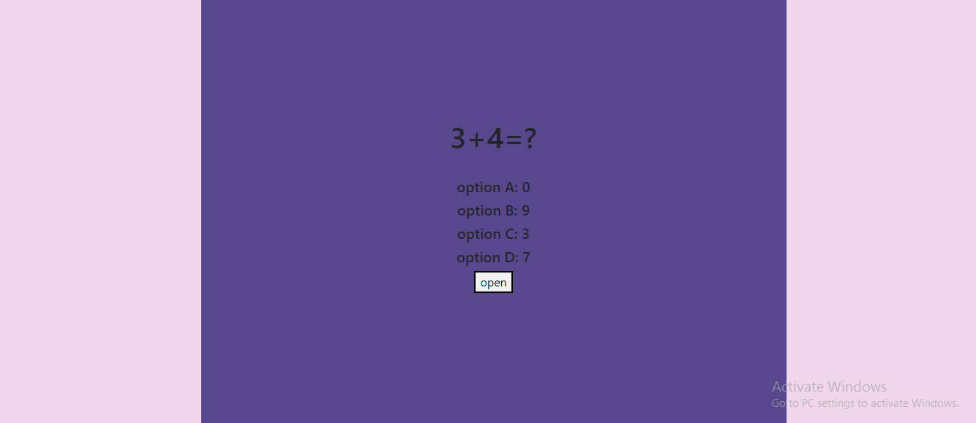
SAMPLE QUESTION

Slide 17
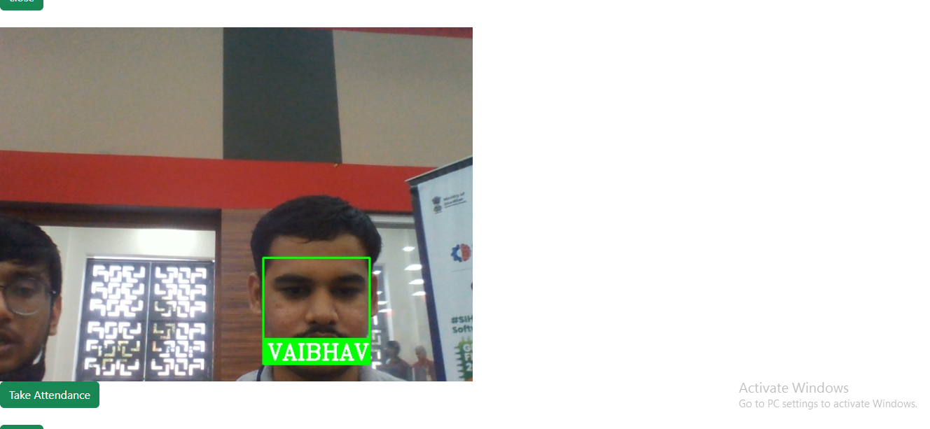
ATTENDANCE

Slide 18
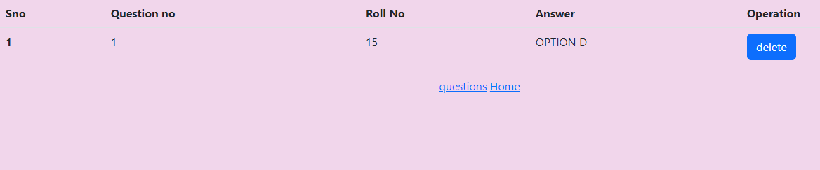
STUDENT PERFORMANCE

Slide 19
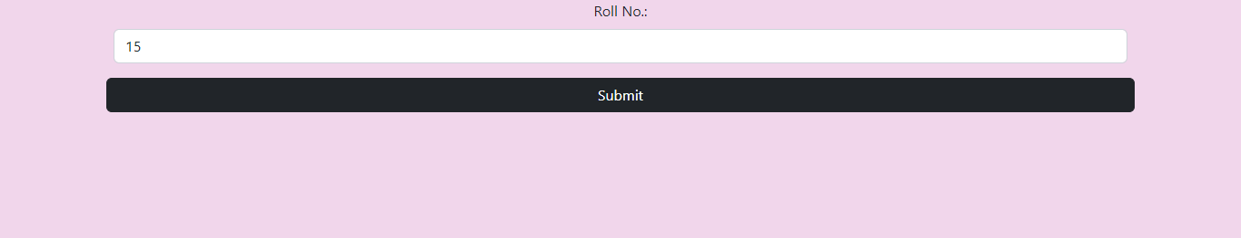
REPORT GENERATION

Slide 20
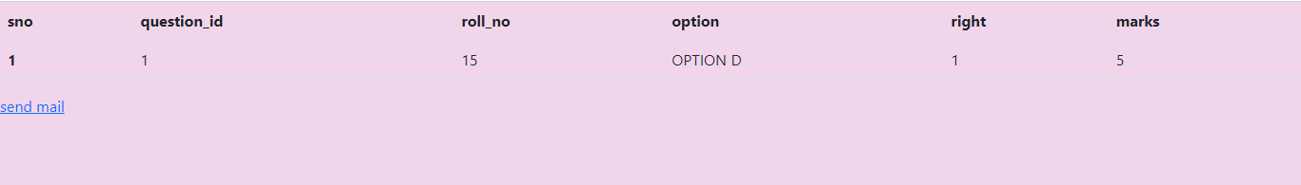
STUDENT’S REPORT

Slide 21
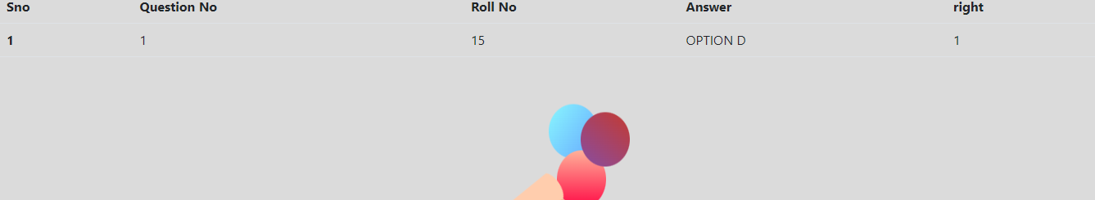
RESULTS

Slide 22
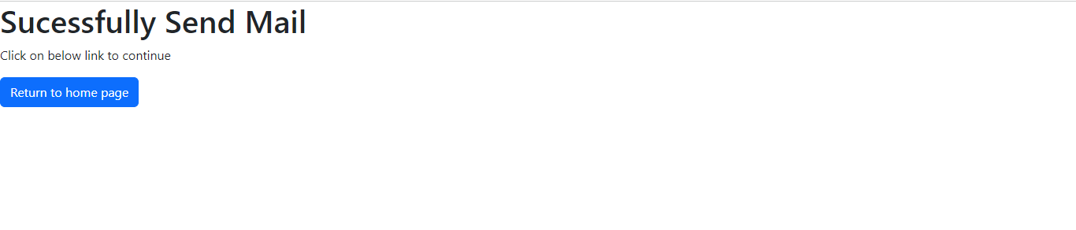
CONFIRMATION OF MAIL

Slide 23
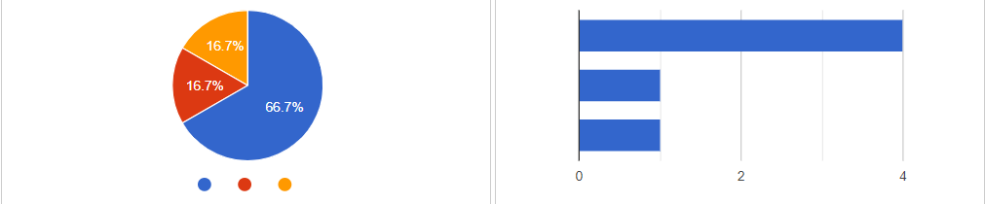
DATA ANALYTICS
CLASS PERFORMANCE

Slide 24
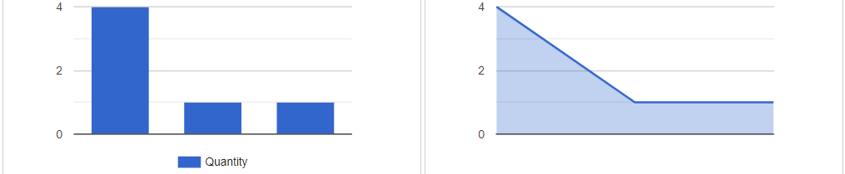
DATA ANALYTICS
CLASS PERFORMANCE

Slide 25
UNIQUE
SELLING
POINT (USP)

Slide 26
WHY CHOOSE EDU-PRO?
1. Why should we choose EDU-PRO when easier methods such as OMR Sheets exist?
OMR sheets require the students to do the bubbling correctly.
They are immutable and options cannot be changed.
There is always a chance of tampering to take place.
2. Why use web based application when mobile applications exists?
Applications require constant updates and that cause an hinderance.
Applications take a lot of space on low end devices as we need space to store the pictures.
Majority of people are more comfortable in using web application as there is more support.

Slide 27
ADVANTAGES OF EDU-PRO
Facility to create new quiz.
Conduction of quiz/ exam with interactive way.
Useful for early grades.
No need of any complex digital devices.
Low efforts at student level.
Easy participation.
Teacher can measure understanding level of student.
Rapid assessment.
Automated result generation.

Slide 28
Benefits
Our project would be primarily used for early grades.

Slide 29
01
Teachers
How Edu-Pro would help the teachers

Slide 30
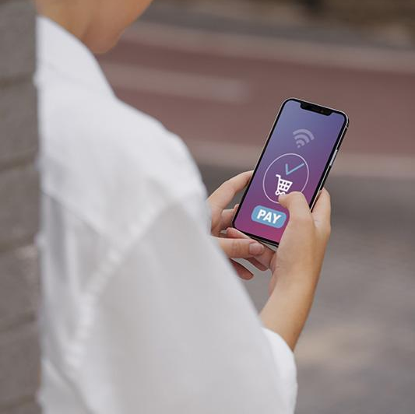
TEACHERS
To conduct quiz easily and help to identity students level of understanding.
To help maintaining student attendance as well as performance record.
Efficient way for conducting exams and interaction than traditional pen paper method.

Slide 31
02
Students
How Edu-Pro would help the students

Slide 32
STUDENTS
The application is useful as student concentration is important to improve the understanding.
It would increase the interaction of the student.
It will also reduce the stress levels of the students as they would not have to manually write the papers.
The students would easily be able to identify their weaknesses and strengths.

Slide 33
03
NDEAR & DoSEL
How Edu-Pro would help NDEAR & DoSEL

Slide 34
NDEAR & DoSEL
System will help to keep track of student performance.
System helps to build new approach for teaching and learning.

Slide 35
SHOWSTOPPERS
RELIABLE
CONVENIENT
ACCURATE
Highly precise and fool-proof database of student’s corresponding profile.
Does not require any specialized equipment and is cross platform
Accurate analysis of student’s selected choice and grip on particular subject.

Slide 36
DEPENDENCY
CAMERA
For best performance, 12 MP & above camera will be required.

Slide 37
CONCLUSION
Our model goes to the core of the problem statement.
Good application for the early grades.
Useful for teachers as well as students for interactive learning.
With less efforts we can have improvement in learning process.
Helpful for knowing the student’s understanding capabilities.

Slide 38
THANK YOU!!!

